Slide 1
REGEDIT
Team Pi

Slide 2
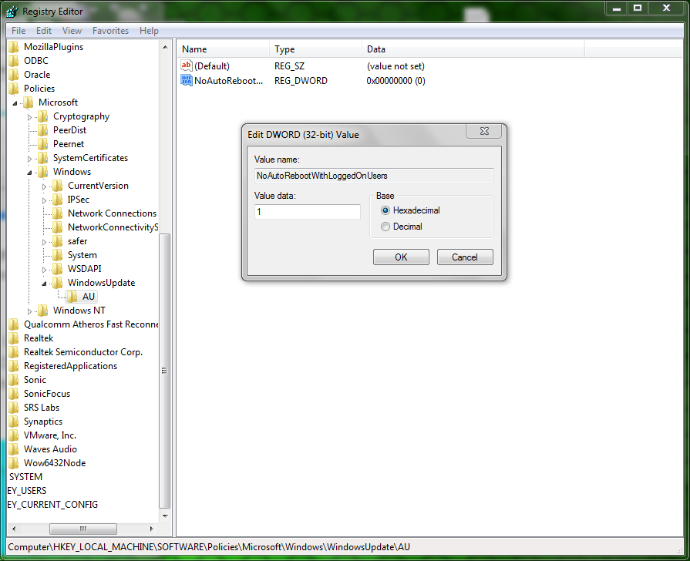
Windows Force Update
To turn off force updating navigate to HKEY_LOCAL_MACHINE\SOFTWARE\Policies\Microsoft\Windows\WindowsUpdate\AU (You will need to add the last two keys.) Then add a sub key of DWORD (32-bit). Name it ‘NoAutoRebootWithLogeedOnUsers’. Set it to one.

Slide 3
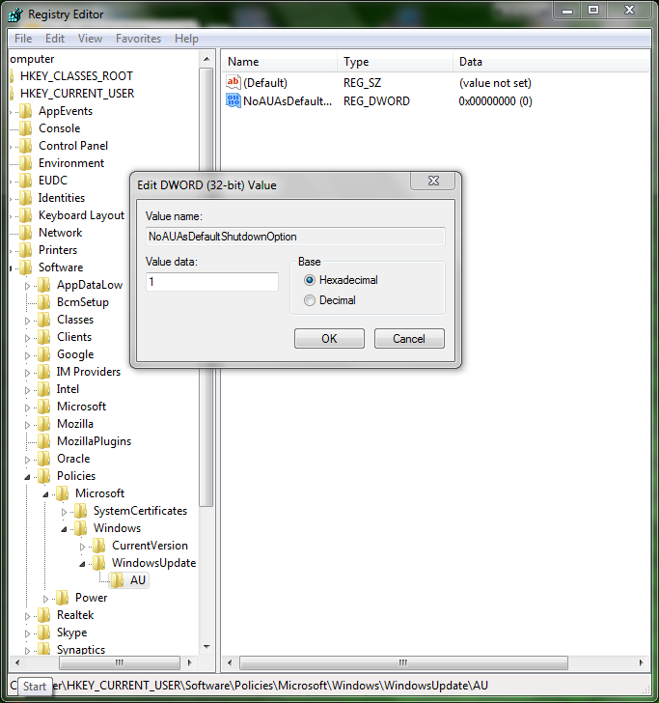
Stop Windows from Hijacking the Power Button
To turn off force updating navigate to HKEY_CURRENT_USER\Software\Policies\Microsoft\Windows\WindowsUpdate\AU (You will need to add the last two keys.) Then add a sub key of DWORD (32-bit). Name it ‘NoAUAsDefaultShutdownOption’. Set it to one.

Slide 4
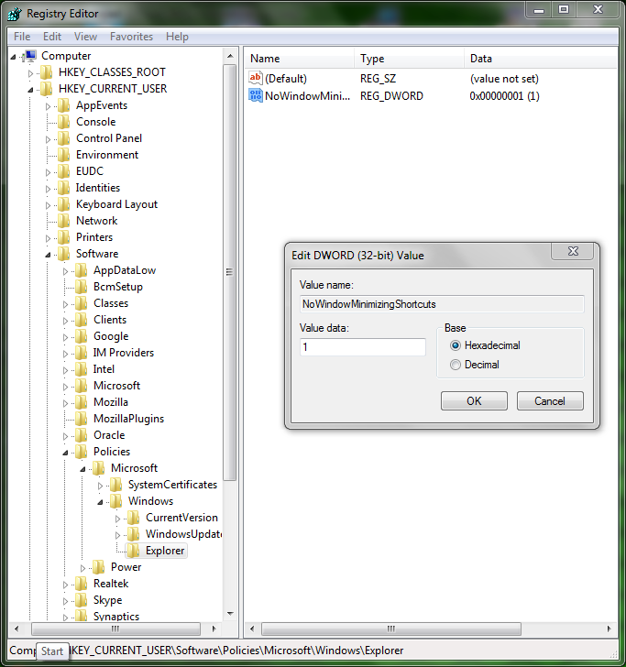
Disable Aero Shake
Navigate to HKEY_CURRENT_USER\Software\Policies\Microsoft\Windows\Explorer (You will need to add the last key) Then add a sub key of DWORD (32-bit). Name it ‘NoWindowMinimizingShortcuts’. Set it to one.

Slide 5
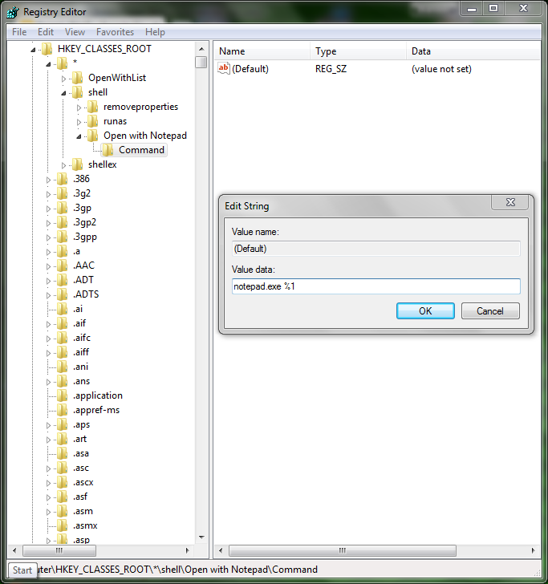
Add “Open with Notepad” to the Context menu for all files
Navigate to HKEY_CLASSES_ROOT\*\shell\Open with Notepad\command (You will need to add the last two keys) Then set default key to ‘notepad.exe %1’

Slide 6
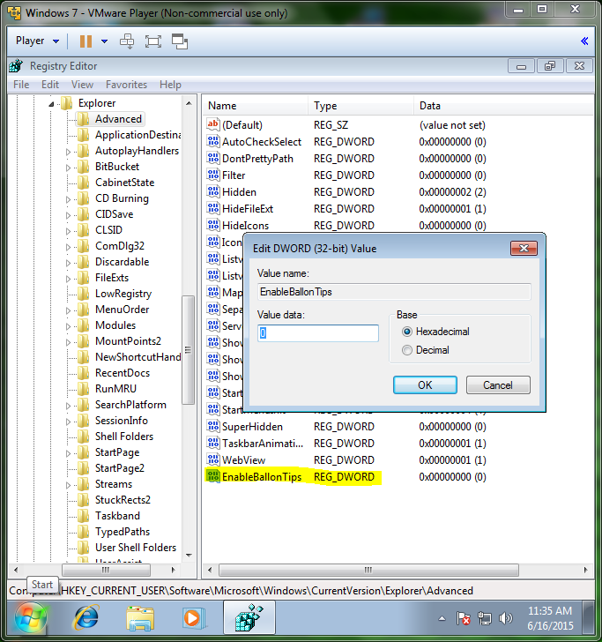
Disable All Notification Balloons
Navigate to HKEY_CURRENT_USER\Microsoft\Windows\CurrentVersion\Explorer\Advanced Then add a sub key of DWORD (32-bit). Name it ‘EnableBalloonTips’. Make sure the value is 0.

Slide 7
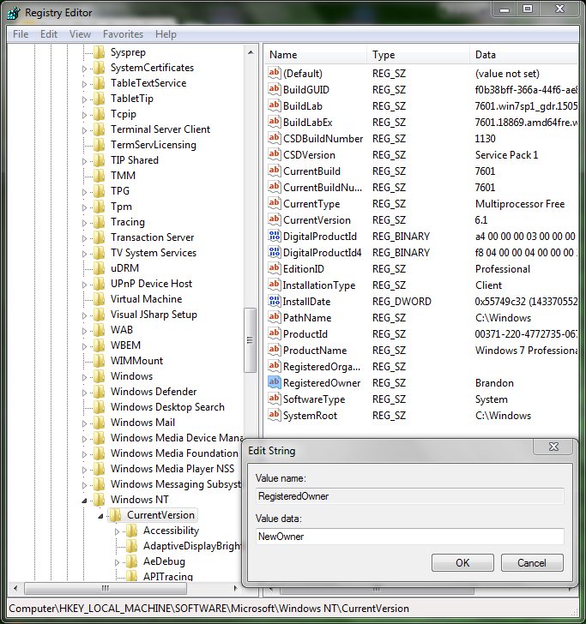
Change the Registered Owner
Navigate to HKEY_LOCAL_MACHINE\SOFTWARE\Microsoft\Windows NT\CurrentVersion Click on RegisteredOwner, set name to new owner.

Slide 8
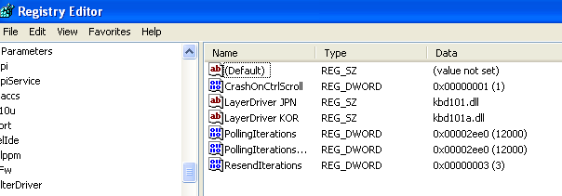
Kill Windows with Blue Screen of Death in 3 keystrokes (XP)
You can configure windows XP to crash on command with the following changes to RegEdit.
After adding this DWORD to the registry holding Ctrl and pressing ScrLk twice will crash your computer

Slide 9
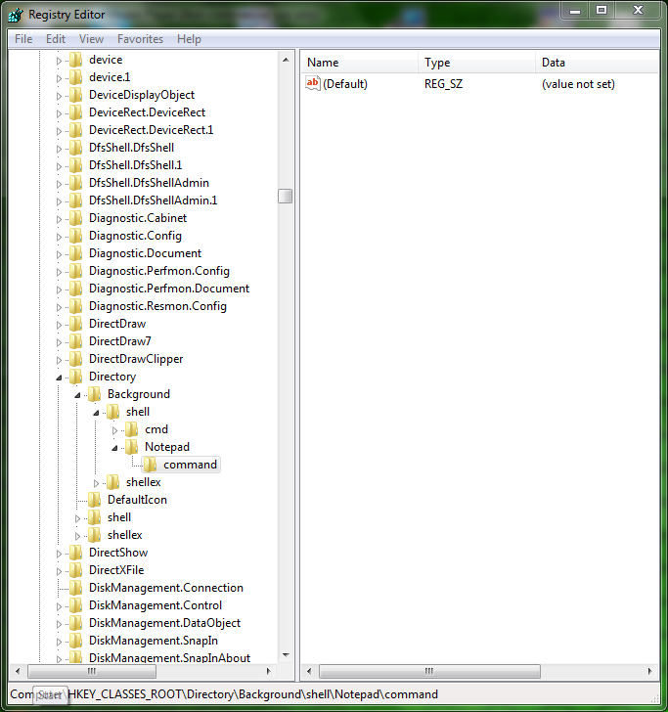
Add Notepad to Windows Desktop Right-Click Menu
Navigate to HKEY_CLASSES_ROOT\Directory\Background\shell
Make a new key and name it ‘Notepad’
Then make a new key named ‘command’

Slide 10
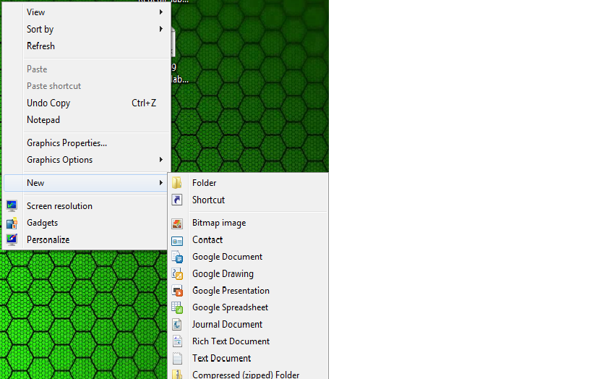
Add Google Documents to the Windows Desktop Right-Click Menu
Download and run this link:
http://cdn5.howtogeek.com/wp-content/uploads/2010/11/AddGoogleDocsToNewMenu.zip
Run the .exe file and drag the icons into your windows directory.

Slide 11
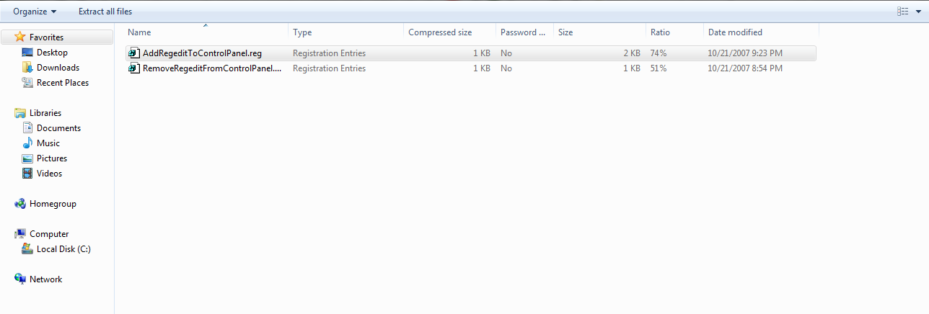
Add Registry Editor to the Control Panel
Download the .reg file from the link and import the key.
http://cdn5.howtogeek.com/wp-content/uploads/gg/AddRegeditToControlPanel.zip

Slide 12
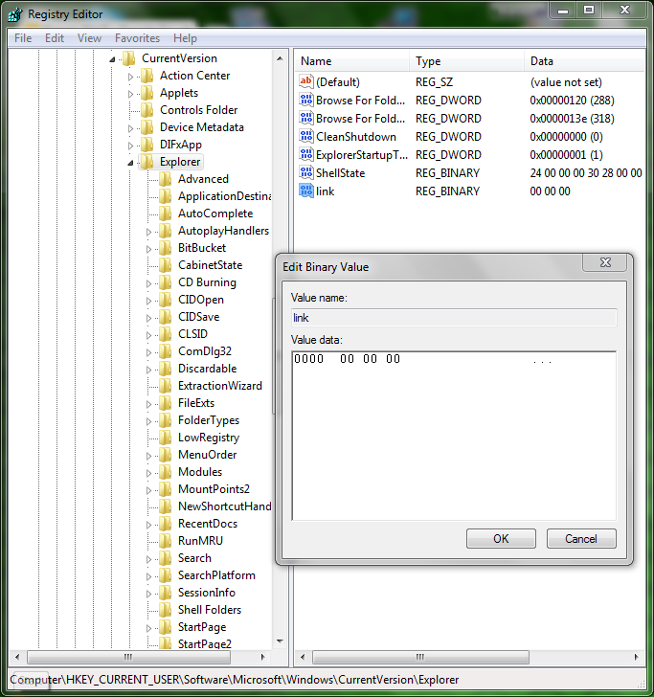
Remove “Shortcut” Text from New Shortcuts
Navigate to HKEY_CURRENT_USER\Software\Microsoft\Windows\CurrentVersion\Explorer Change ‘link’ value to ‘00 00 00 00’.

Slide 13
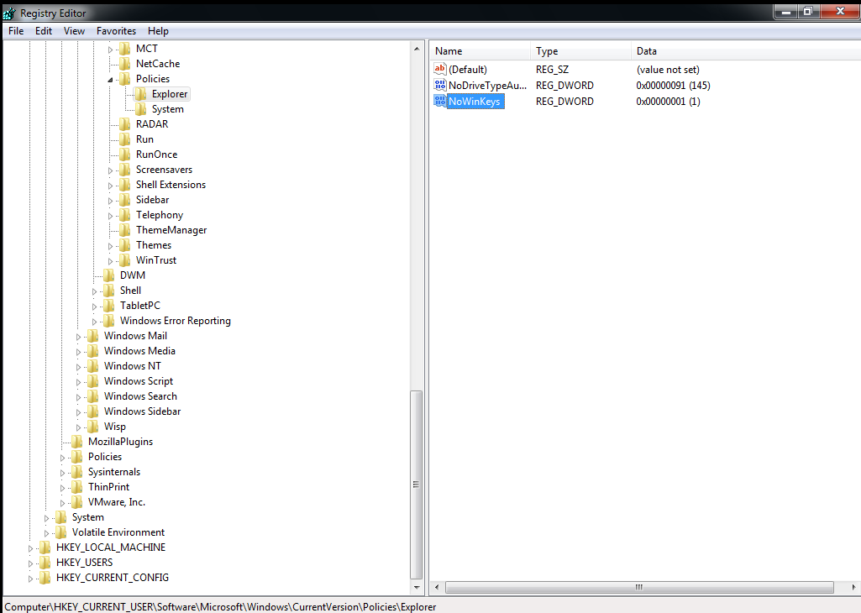
Disable WIN+X Shortcut Keys
Navigate to HKEY_CURRENT_USER\Software\Microsoft\Windows\CurrentVersion\Policies\Explorer. Create a new 32 bit DWORD value called NoWinKeys and set it to 1.

Slide 14
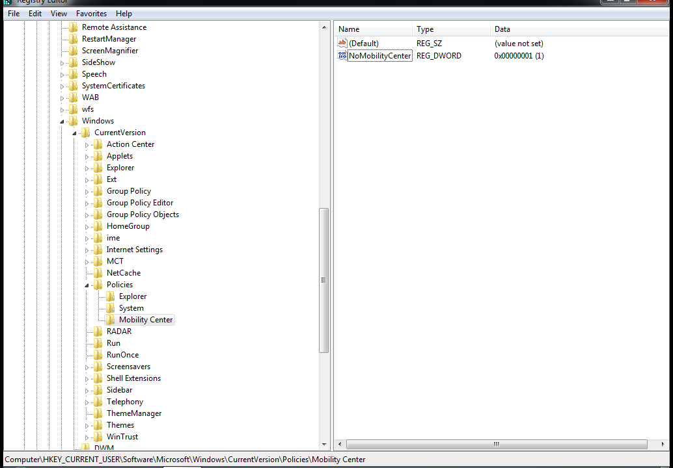
Disable Windows Mobility Center
Navigate to HKEY_CURRENT_USER\Software\Microsoft\Windows\CurrentVersion\Policies. Add a new Key called Mobility Center. Within that key create a 32 bit DWORD value called NoMobilityCenter and set it to 1.

Slide 15
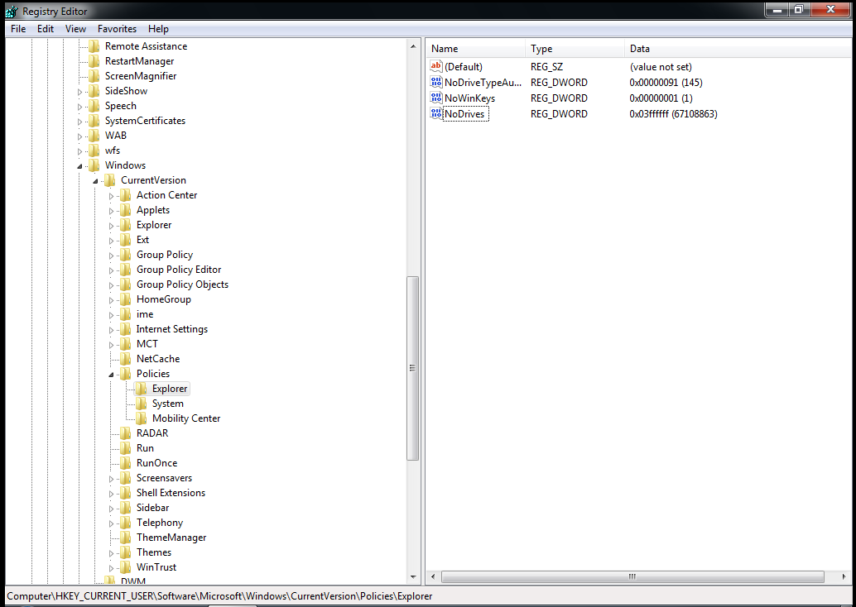
Hide Drives from Your Computer
Navigate to HKEY_CURRENT_USER\Software\Microsoft\Windows\CurrentVersion\Policies\Explorer. Create a new value called NoDrives and set it to 67108863.

Slide 16
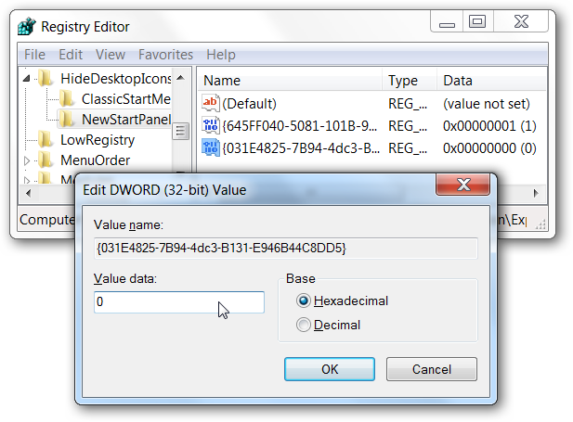
Put a Real Libraries Icon on your Desktop
Navigate to HKEY_CURRENT_USER\Software\Microsoft\Windows\
CurrentVersion\Explorer\HideDesktopIcons\NewStartPanel. Create a new 32-bit DWORD value on the right-hand side, and give it the name {031E4825-7B94-4dc3-B131-E946B44C8DD5} and the value of 0

Slide 17
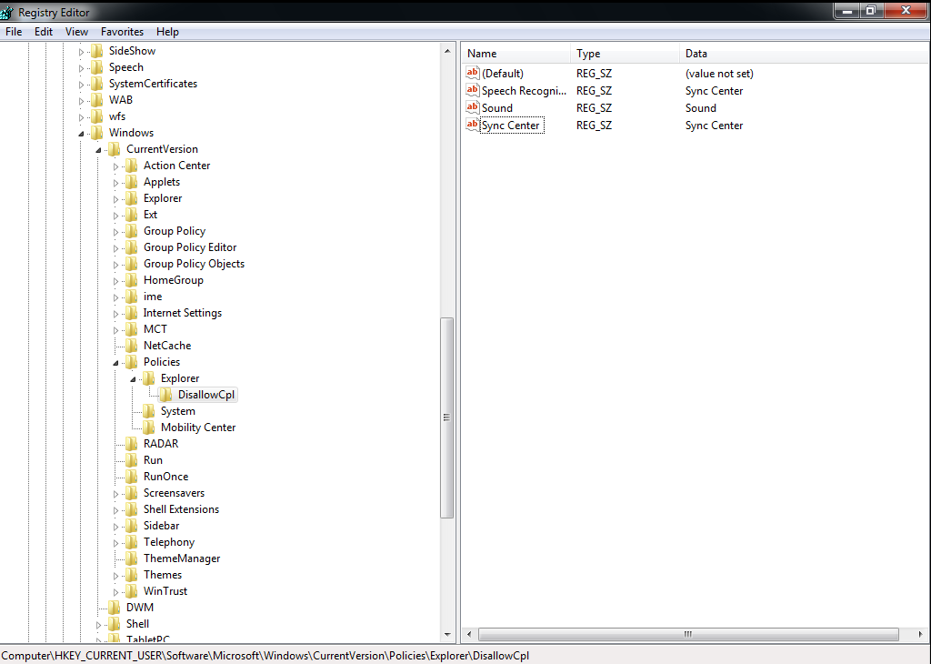
Remove or Hide Unwanted Items from the Control Panel
HKEY_CURRENT_USER\Software\Microsoft\Windows\CurrentVersion\Policies\Explorer. Create a new 32 bit DWORD value called Disallow.Cpl. Then create a new key called DisallowCpl. Now within the DisallowCpl key, create a new String value for each of the items you don’t want showing in Control Panel.

Slide 18
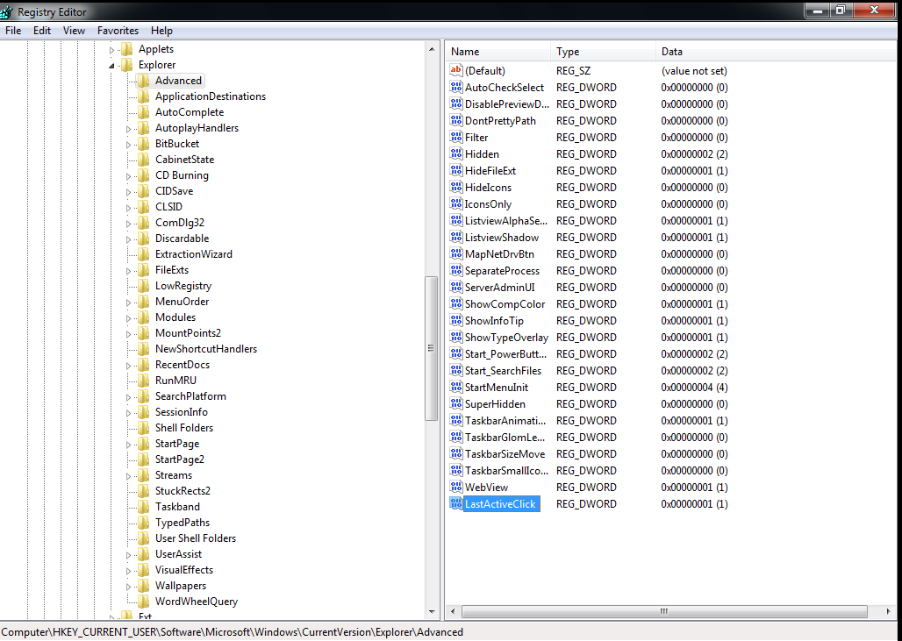
Make the Taskbar Buttons Switch to the last Active Window
Navigate to HKEY_CURRENT_USER\Software\Microsoft\Windows\CurrentVersion\Explorer\Advanced. Create a new 32 bit DWORD value called LastActiveClick and set it to 1.

Slide 19
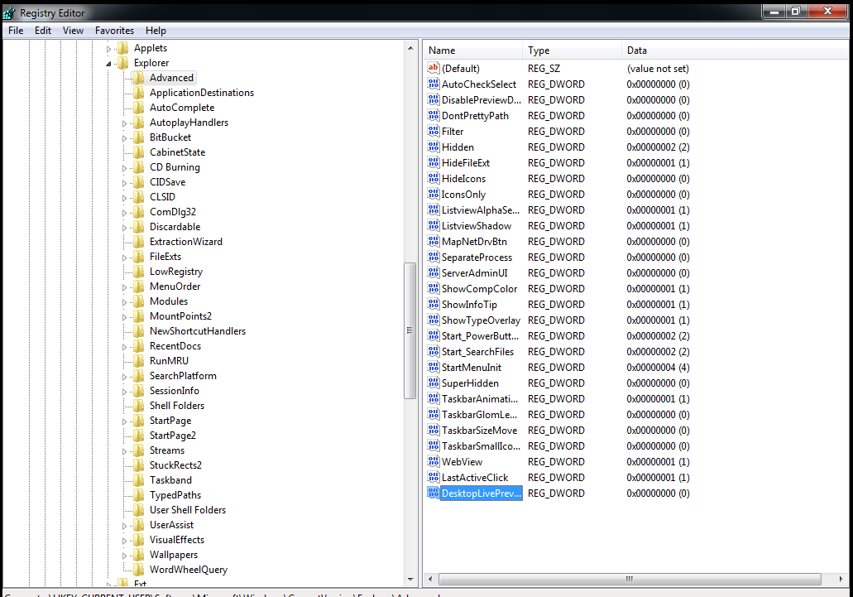
Make Aero Peek Display Instantly (or Disable it)
Navigate to HKEY_CURRENT_USER\Software\Microsoft\Windows\CurrentVersion\Explorer\Advanced. Create a new 32 bit DWORD value called DesktopLivePreviewHoverTime and set it to 0.

Slide 20
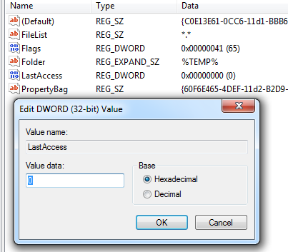
Make disk Cleanup Delete Everything from the Temp Folder
To make disk cleanup clear the entire temp folder we change the setting so that anything older than 0 days is deleted.
This is in the Temporary Files section of the Registry.

Slide 21
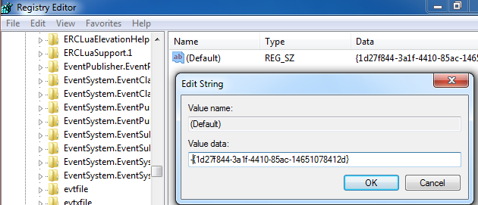
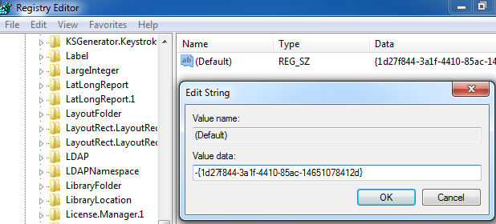
Remove “Troubleshoot Compatibility” from the Windows Context Menu
Navigate to the exefiles compatibility Section of the Registry and edit the script on the side. You can delete the key, but it’s safer to add a dash before the value in case you ever want to restore the setting. Next do the same for the lnkfile setting, and you’ll have removed Troubleshoot Compatibility.

Slide 22
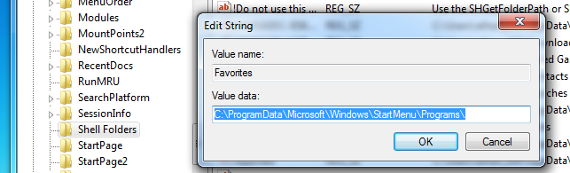
Show the Classic “All Programs” Menu in the Start Menu
Move through the registry to the Shell Folders. Select the favorites option and change the value to “C:\ProgramData\Microsoft\Windows\StartMenu\Programs\” Do the same in the Users Shell Folders section below

Slide 23
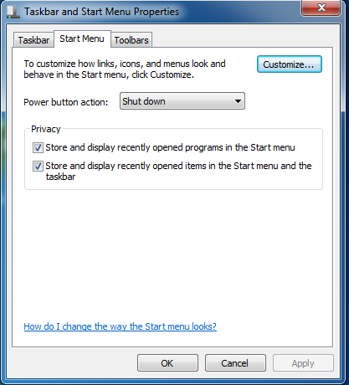
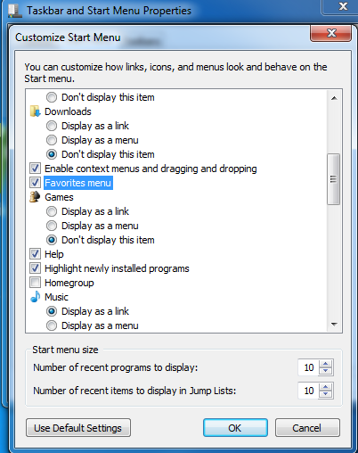
Show the Classic “All Programs” Menu in the Start Menu
Next right click the start menu and choose properties, then customize.
Next, scroll down to the box that says favorites menu and check it.
Restart your computer and you’ll have the old menu back.

Slide 24
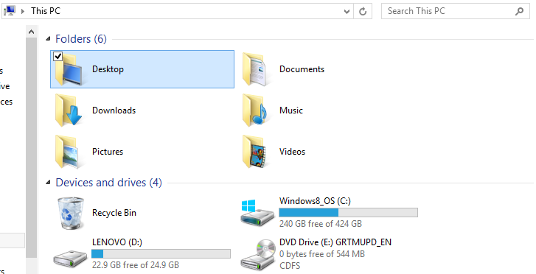
Add Recycle Bin to “My Computer”
Navigate to the My Computer > Name Space section of the registery and create a new key. Name the new key with this string.
{645FF040-5081-101B-9F08-00AA002F954E}
After this the My Computer folder will contain a Recycling Bin.

Slide 25
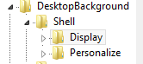
Remove Gadgets and Screen Resolution on Desktop Context Menu
To remove these options from the desktop context menu, you must find the desktop background in the registry. Enter the shell section and delete display and gadgets. My computer was already missing the gadget option, so the picture on the right only shows the Display option.

Slide 26

Enable More Fonts for the Windows Command Prompt
Enabling more fonts for the command prompt is an easy edit in the registry.
Navigate to the console menu and simply add a new script with aunique name and set it’s data to the name of the font you want to use.

Slide 27
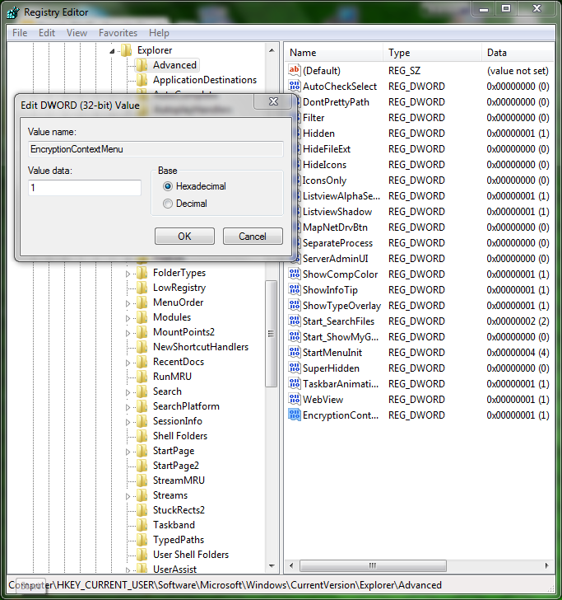
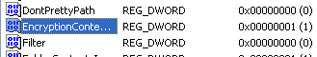
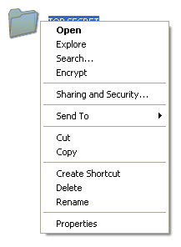
Add Encrypt/Decrypt Options to the Right-Click Menu
In the registry editor find the section that controls Explorer and enter the advanced section. From here add a DWORD called “EncryptionContextMenu”
Give it a value of 1 to activate it and you can now encrypt and decrypt files from the context menu.
HKEY_CURRENT_USER\Software/Microsoft\Windows\CurrentVersion\Explorer\Advanced
Make a new 32-bit DWORD value called ‘EncryptionContextMenu’
Assign it a value of one.

Slide 28
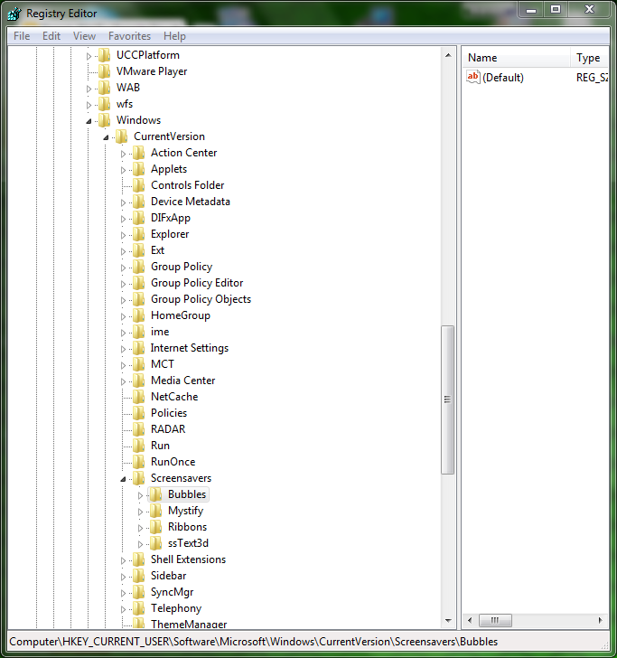
Customize the Default Screensavers
Navigate to
HKEY_CURRENT_USER\Software\Microsoft\Windows\Current Version\Screensavers
Edit the screensaver of your choice.

Slide 29
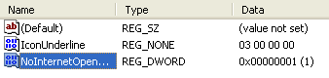
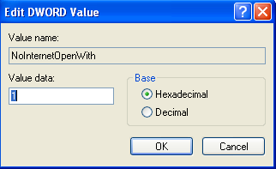
Skip the Annoying “Use the Web service to find the correct program” Dialog
To skip this dialogue find the part of RegEdit that controls Explorer.
Next, add a new DWORD and edit it to match the one on the right.

Slide 30
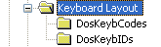
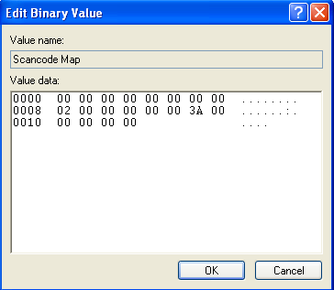
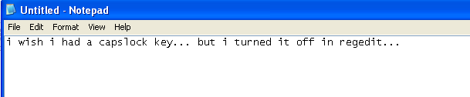
Disable Caps Lock Key
Turning off the capslock key is found in the Keyboard Layout section of RegEdit. Once inside add a new Binary Value, and set it as shown on the right

Slide 31
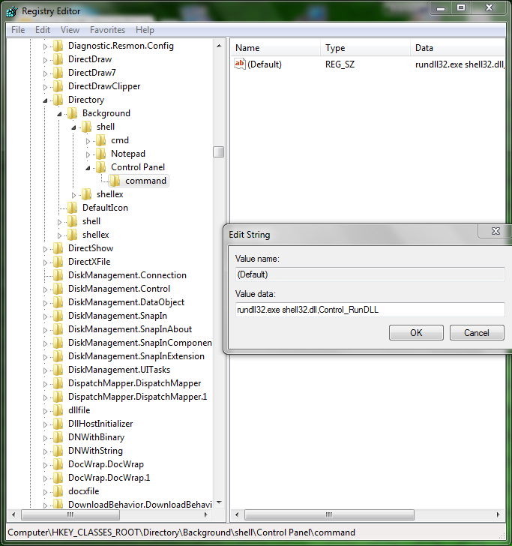
Add Control Panel to the Desktop Right-Click Menu
Navigate to HKEY_CLASSES_ROOT\Directory\Background\shell
Add a new key named ‘Control Panel’, under Control Panel add another key named ‘command’.
Set the default value of command to ‘rundll32.exe shell32.dll,Control_RunDLL

Slide 32
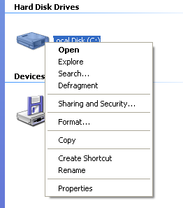
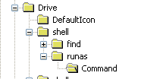
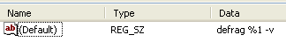
Add Defragment to the Right-Click Menu for a Drive
To add “Defragment” to the context menu…
Open RegEdit
Navigate to the Drive section
Create a new Key called “runas” and a subkey, “Command”
Set the Command Key data to “defrag %1 -v”

Slide 33
REGEDIT Part 2

Slide 34
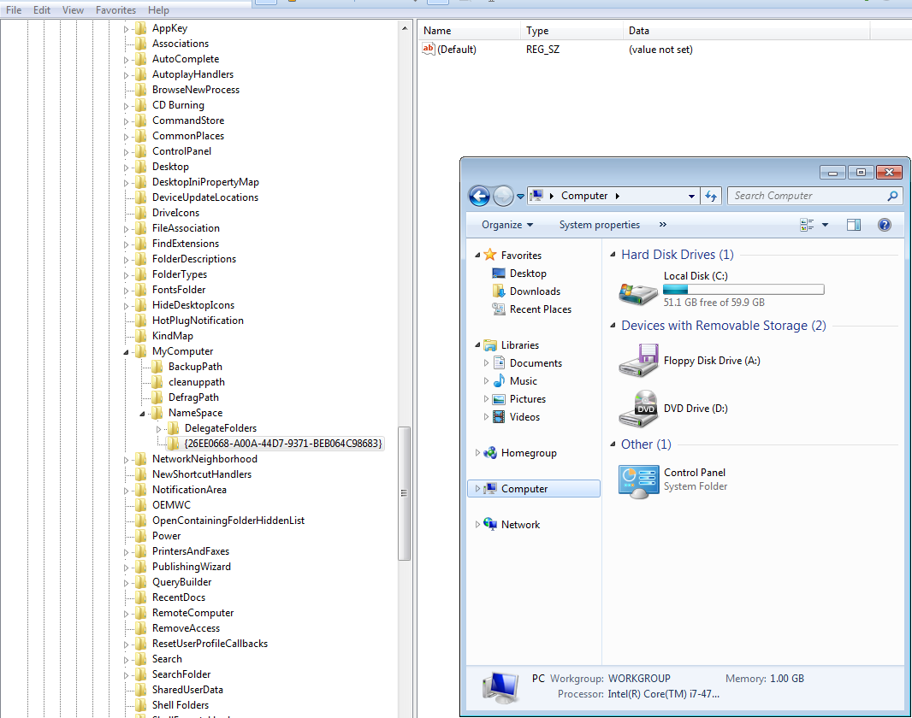
Add Control Panel to “My Computer”
Navigate to HKEY_LOCAL_MACHINE\Software\Microsoft\Windows\CurrentVersion\Explorer\MyComputer\NameSpace
Make a new key and name it ‘{26EE0668-A00A-44D7-9371-BEB064C98683}’

Slide 35
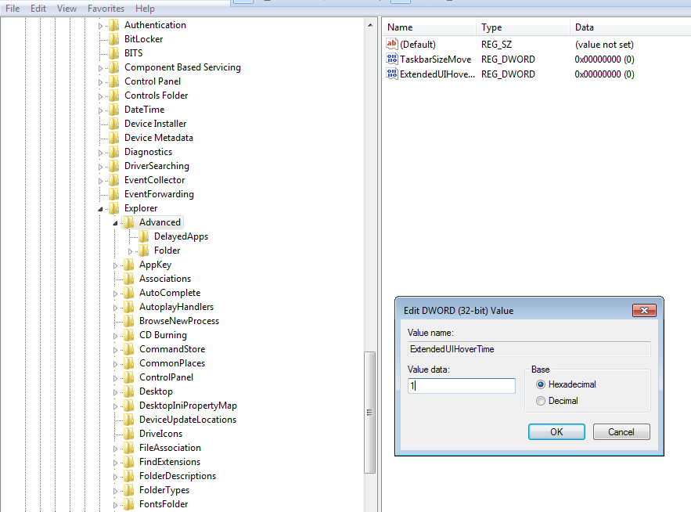
Increase the Speed of the Aero Taskbar Thumbnails
Navigate to HKEY_CURRENT_USER\Software\Microsoft\Windows\CurrentVersion\Explorer\Advanced
Make a new key and name it ‘ExtendUIHoverTime’
Set Value to 1

Slide 36
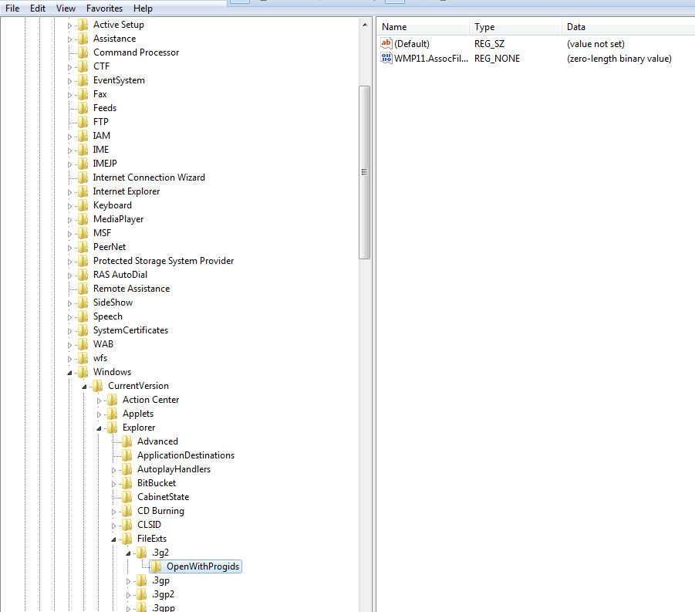
Remove Programs from the Open With Menu in Explorer
Navigate to
HKEY_CURRENT_USER\Software\Microsoft\Windows\CurrentVersion\Explorer\FileEXts\
Select the file extension, delete the key that list the program.

Slide 37
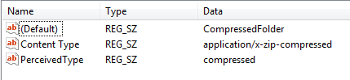
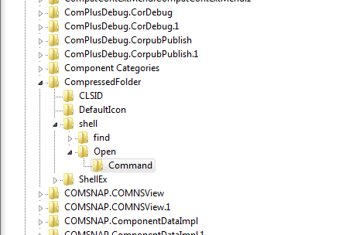
Add “Run as Administrator” to Any File Type
Navigate to HKEY_CLASSES_ROOT\.zip
Look at the data of the default subkey.
Go to what it says under HKEY_CLASSES_ROOT
Export *\shell\open\Command

Slide 38
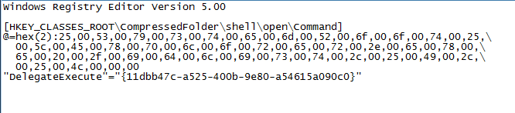
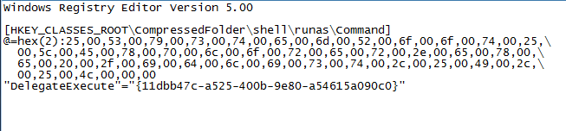
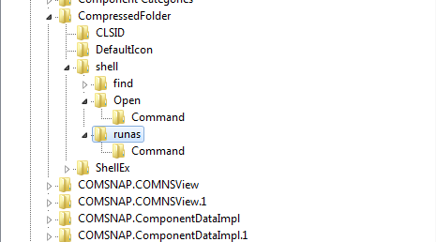
Add “Run as Administrator” to Any File Type
Edit they key: change ‘open’ to ‘runas’ and save.
Double click the file to merge and check the registry to make sure it added the new key.

Slide 39
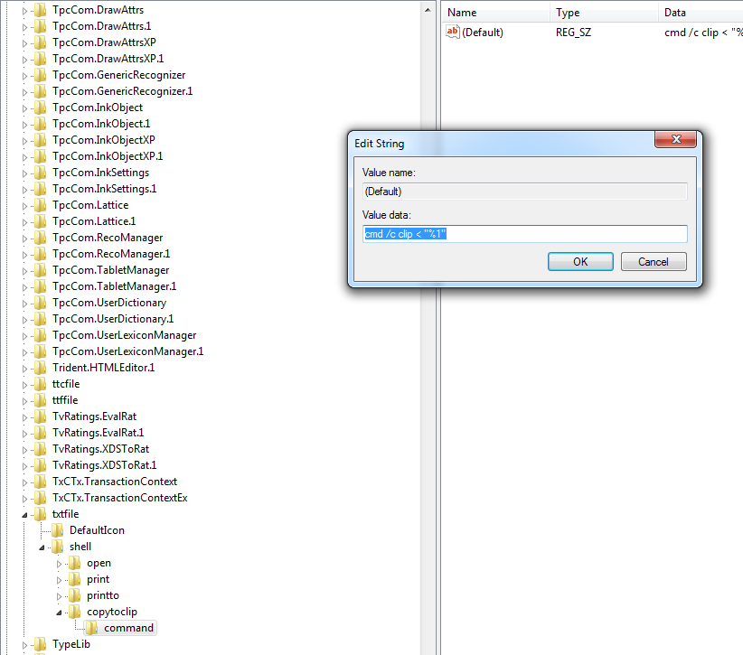
Create a Context Menu Item to Copy a Text File to the Clipboard
Navigate to
HKEY_CLASSES_ROOT\txtfile\shell
Make a new key named ‘copytoclip’
Make a new key under ‘copytoclip’ named ‘command’
Assign the ‘command’ default value ‘cmd /c clip < “%1”

Slide 40
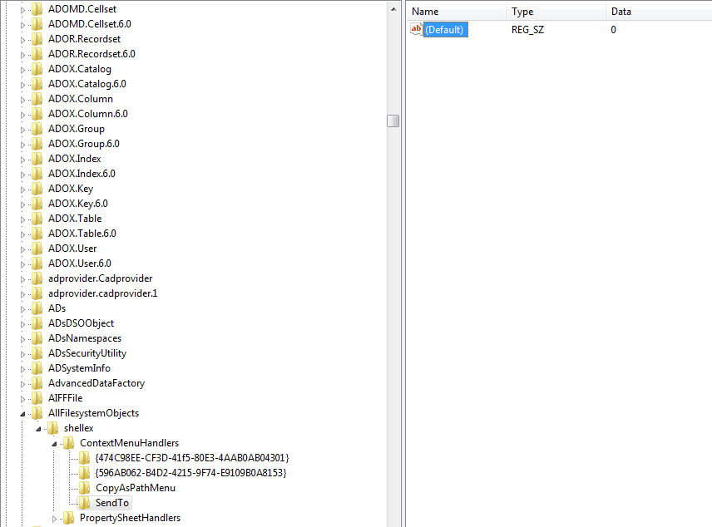
Disable the “Send To” Folder on the Windows Explorer Context Menu
Navigate to
HKEY_CLASSES_ROOT\AllFilesystemObjects\shellex\ContextMenuHandlers\Send To
Set the default value to 0

Slide 41
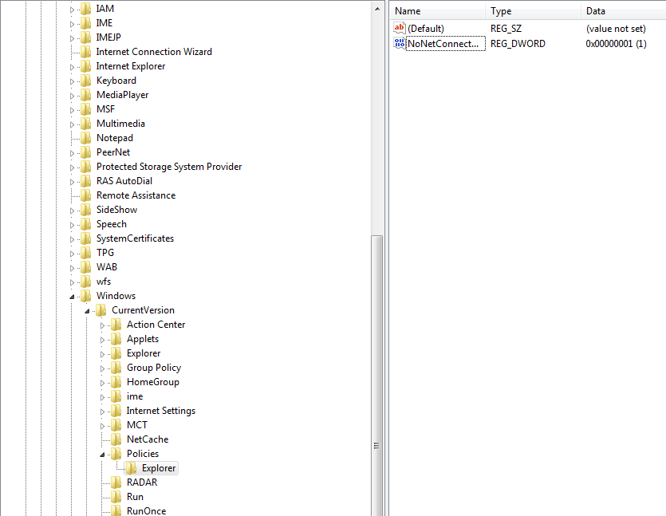
Remove “Map Network Drive” Menu Item from Windows
Navigate to
HKEY_CURRENT_USER\Software\Microsoft\Windows\CurrentVersion\Policies\Explorer
Make a new DWORD subkey named ‘NoNetConnectDisconnect’
Set value to 1

Slide 42

Disable Task Manager
Navigate to
HKEY_CURRENT_USER\Software\Microsoft\Windows\CurrentVersion\Policies\System
Make a new DWORD subkey named ‘NoNetConnectDisconnect’
Set value to 1

Slide 43

Restore the Real Internet Explorer Desktop Icon
Export
HKEY_CLASSES_ROOT \ CLSID \ {871C5380-42A0-1069-A2EA-08002B30309D}
Edit and replace all ‘{871C5380-42A0-1069-A2EA-08002B30309D}’
with ‘{871C5380-42A0-1069-A2EA-08002B30301D}’

Slide 44
Restore the Real Internet Explorer Desktop Icon
Import key and navigate to HKEY_CLASSES_ROOT \ CLSID \ {871C5380-42A0-1069-A2EA-08002B30301D} \ Shellex \ ContextMenuHandlers \ ieframe
Set default subkey to ‘{871C5380-42A0-1069-A2EA-08002B30309D}’

Slide 45

Enable or Disable Displaying a Message During the Boot Process
Navigate to
HKEY_LOCAL_MACHINE\SOFTWARE\Microsoft\
Windows\CurrentVersion\Policies\System
Make a new DWORD subkey named VerboseStatus set to 1.

Slide 46

Create a Hidden User Account
Create a user.
Navigate to
HKEY_LOCAL_MACHINE\SOFTWARE\Microsoft\WindowsNT\CurrentVersion\Winlogon\SpecialAccounts\UserListModify
Select user and change value to 1

Slide 47

Prevent Programs from Loading at Startup
Create a user.
Navigate to
HKEY_LOCAL_MACHINE\SOFTWARE\Microsoft\Windows\CurrentVersion\Run
Delete key for program

Slide 48

Sort Menus Alphabetically
Navigate to HKEY_CURRENT_USER\Software\Microsoft\ Windows\CurrentVersion\Explorer\MenuOrder\
Click ‘Advanced’ then uncheck ‘Include inheritable...’

Slide 49

Change the Desktop Cleanup Frequency
Navigate to
HKEY_CURRENT_USER\Software\Microsoft\Windows\CurrentVersion\Explorer\Desktop\CleanupWiz
Make a new DWORD named ‘Days between clean up’
Set the value equal to the number of days

Slide 50


Use Desktop Patterns
Navigate to
HKEY_CURRENT_USER\Control Panel\Patterns
Set value to one on list.

Slide 51

Delete The Files Stored on this Computer Category in My Computer Window
Navigate to
HKEY_LOCAL_MACHINE\SOFTWARE\Microsoft\Windows\CurrentVersion\Explorer\MyComputer\NameSpace\DelegateFolders
Delete the sub-key labeled ‘{59031a47-3f72-44a7-89c5-5595fe6b30ee}’

Slide 52

Erase the Swap File at Shutdown
Navigate to
HKEY_LOCAL_MACHINE\SYSTEM\CurrentControlSet\Control\Session Manager\Memory Management
Change value of ‘ClearPageFileAtShutdown’ to 1

Slide 53
Adjust System Restore Values
The three registry subkeys are:
HKEY_LOCAL_MACHINE\SYSTEM\CurrentControlSet\Services\Sr
HKEY_LOCAL_MACHINE\SYSTEM\CurrentControlSet\Services\SrService
HKEY_LOCAL_MACHINE\SOFTWARE\Microsoft\Windows NT\CurrentVersion\SystemRestore

Slide 54

Create a Right-Click Command Prompt Option
Navigate to HKEY_LOCAL_MACHINE/Software/Classes/Folder/Shell. Create a new key called Command Prompt. Your default value should be Command Prompt Here. Create a new key called Command under the Command Prompt key. Your default value should be cmd.exe /k pushd %L

Slide 55

Only Users1-5 Can Have Full Control of Regedit Class and The Rest of The Users Can Only Read the Regedit Class
In regedit click on Edit and the Permissions. Add the users you want and choose what permissions they have.

Slide 56


Restore Previous Versions of the Registry
First disable User Account Control. Then navigate to C:\Windows\System32\Config and go to properties and click Previous Versions. Select the Registry Hive Files you need and copy them to a folder of your choice. Then go to regedit and click File and choose Load Hive.

Slide 57
REGEDIT Part 2
Windows 8

Slide 58

Change the Maximum Number of Tile Rows on Start Screen
Navigate to HKEY_CURRENT_USER\Software\Microsoft\Windows\CurrentVersion\ImmersiveShell\Grid. Add a new Key called Mobility Center. Within that key create a 32 bit DWORD value called Layout_MaximumRowCount and set it to 1.

Slide 59

Set Border Size of Desktop Windows
Navigate to HKEY_CURRENT_USER\Control Panel\Desktop\WindowMetrics. Change the BorderWidth and PaddedBorderWidth values to change the size.

Slide 60

Set Custom Desktop Icon Vertical & Horizontal Spacing
Navigate to HKEY_CURRENT_USER\Control Panel\Desktop\WindowMetrics. Change the IconSpacing and IconVerticalSpacing values to change the spacing.

Slide 61

Enable Confirm File Delete Dialog
Navigate to HKEY_CURRENT_USER\Software\Microsoft\Windows\CurrentVersion\Policies\Explorer. Create a new DWORD file named ConfirmDelete and set it to 1

Slide 62

Find out the Registered Owner
Navigate to HKEY_LOCAL_MACHINE\Software\Microsoft\Windows NT\CurrentVersion. Locate the RegisteredOwner value.

Slide 63

Paint Desktop Version in the Desktop
Navigate to HKEY_CURRENT_USER\Control Panel\Desktop\. Change the PaintDesktopVersion value to 1.

Slide 64

Prevent Users from Uninstalling Apps
Navigate to HKEY_CURRENT_USER\Software\Policies\Microsoft\Windows. Create a new key called Explorer and then within Explorer create a new DWORD value called NoUninstallFromStart and set it to 1.

Slide 65

Enable Snap on Low Res Screens
Navigate to HKEY_CURRENT_USER\Software\Microsoft\Windows\CurrentVersion\ImmersiveShell\Grid. Add a new Key called AppPositioner. Within that key create a 32 bit DWORD value called AlwaysEnableLSSnappingt and set it to 1.

Slide 66

Re-Enable the Classic Start Menu
Navigate to HKEY_CURRENT_USER\Software\Microsoft\Windows\CurrentVersion\Explorer. Change RPEnabled to 0.

Slide 67

Find Windows 8 Product Key
Navigate to HKEY_LOCAL_MACHINE\Software\Microsoft\Windows NT\CurrentVersion. Locate the ProductID value.

Slide 68
Resources
http://www.howtogeek.com
http://www.neowin.net/news/windows-8-how-to-re-enable-the-classic-start-menu
http://www.isunshare.com/product-key-finder/find-product-key-for-windows-8-or-8.1.html
https://support.microsoft.com/en-us/kb/295659

